Slide 1
Phase Angle Measurement Circuit Or A Power Factor Measurement Circuit.
Roshan S. Jadhav
Shruti k. Gangurde
G Aman Kumar
Rajesh Kamble

Slide 2
Abstract
The Phase Angle Measurement Circuit and Power Factor Measurement Circuit are essential components in electrical engineering for analyzing the efficiency and quality of power systems. These circuits enable precise measurement of the phase angle between voltage and current waveforms, as well as the power factor, which are critical parameters for assessing the performance of electrical loads. By accurately quantifying the phase relationship between voltage and current, these circuits provide valuable insights into the reactive power consumption and overall efficiency of electrical equipment. Their applications range from industrial power systems to renewable energy installations, where optimizing power factor and phase angle is essential for minimizing energy losses and maximizing system reliability. Through their compact design and precise measurement capabilities, these circuits play a vital role in ensuring the efficient operation of electrical networks in various sectors.

Slide 3
Introduction
The Phase Angle Measurement Circuit and Power Factor Measurement Circuit are fundamental components in electrical engineering, crucial for assessing the performance and efficiency of power systems. These circuits play a pivotal role in analyzing the phase relationship between voltage and current waveforms, as well as quantifying the power factor of electrical loads. By providing accurate measurements of phase angle and power factor, these circuits enable engineers to optimize energy usage, improve system stability, and reduce wastage in diverse applications. Their importance spans across industries, including manufacturing, utilities, and renewable energy, where precise control of power factor is essential for enhancing overall system efficiency and reliability. This introduction highlights the significance of Phase Angle Measurement and Power Factor Measurement Circuits in modern electrical engineering practices.

Slide 4
Literature review
• In "Phase Angle Measurement Techniques: A Review" by Sharma et al. (2019), the authors discuss various methods and techniques used for phase angle measurement in power systems, including analog and digital approaches.
• "A Review on Phase Angle Measurement and Its Applications" by Gupta et al. (2020) provides an overview of the importance of phase angle measurement in power quality analysis and control, highlighting its applications in renewable energy systems and smart grids.
• Zhang et al. (2018) explore the advancements in phase angle measurement technology and its role in grid synchronization and stability analysis in their paper "Recent Advances in Phase Angle Measurement Techniques for Power Systems".
• "Comparison of Phase Angle Measurement Techniques for Power Systems" by Li and Wang (2017) compares different phase angle measurement techniques, including voltage and current synchronization methods, phase-locked loop (PLL) techniques, and digital signal processing (DSP) algorithms.

Slide 5
Cont..
Singh et al. (2019) review the advancements in power factor measurement techniques and their applications in energy management systems in their paper "Recent Trends in Power Factor Measurement Techniques".
"A Review on Power Factor Measurement Techniques and Their Applications" by Das et al. (2020) provides insights into the various methods used for power factor measurement, including analog and digital approaches, and discusses their significance in power quality assessment.
Kumar et al. (2018) discuss the challenges and opportunities in power factor measurement in their paper "Power Factor Measurement Techniques: Challenges and Future Trends".
"Power Factor Measurement: A Review" by Mishra and Mishra (2016) offers a comprehensive review of power factor measurement techniques, emphasizing their importance in energy efficiency and power quality improvement initiatives.

Slide 6
Problem statement
The accurate measurement and analysis of electrical parameters in power systems are critical for ensuring optimal efficiency and reliability. However, existing methods often suffer from precision issues or necessitate complex setups, posing challenges for practical implementation. These limitations hinder the ability to precisely assess crucial parameters like voltage, current, phase angle, and power factor. Without accurate measurements, it becomes challenging to identify inefficiencies, diagnose faults, or optimize energy consumption. Therefore, there is a pressing need for innovative solutions that can provide reliable and precise measurements of electrical parameters in power systems, enabling enhanced efficiency and performance. Addressing these challenges is essential for advancing the reliability and sustainability of electrical infrastructure across various sectors.

Slide 7
Objective
The objective is to develop a Phase Angle Measurement Circuit or a Power Factor Measurement Circuit that offers precise and reliable measurement of phase angle or power factor, respectively. This circuit should be cost-effective, easy to implement, and suitable for various applications in power systems.
Specifically, the aim is to design a circuit that can accurately measure the phase difference between voltage and current waveforms in electrical systems or calculate the power factor to assess the efficiency of power consumption.

Slide 8
Existing System
Phase Angle Measurement Circuit: Utilizes analog or digital techniques such as phase shifters, zero crossing detection, or digital signal processing to measure the phase difference between voltage and current signals. Arduino-based solutions offer cost-effective and versatile options for phase angle measurement.
Power Factor Measurement Circuit: Implements methods like the wattmeter technique, reactive power compensation, digital power analyzers, or harmonic analysis to assess power factor. These circuits enable accurate evaluation of power factor, essential for optimizing energy efficiency and system stability in electrical networks.
Drawbacks:
• Manual references are required

Slide 9
Proposed System
The Phase Angle Measurement Circuit employs an Arduino UNO microcontroller interfaced with voltage and current sensors to determine the phase difference between voltage and current waveforms. The Arduino UNO reads analog signals from the sensors, processes them using digital signal processing algorithms, and calculates the phase angle. The calculated phase angle is then displayed on an LCD screen for user visualization and monitoring. Additionally, the Arduino UNO facilitates data logging and transmission for further analysis. This method offers a cost-effective and versatile solution for phase angle measurement, suitable for various applications in power systems analysis and control.

Slide 10
Block diagram
Power supply
Bulb
Arduino
Relay
PZEM004
LCD

Slide 11
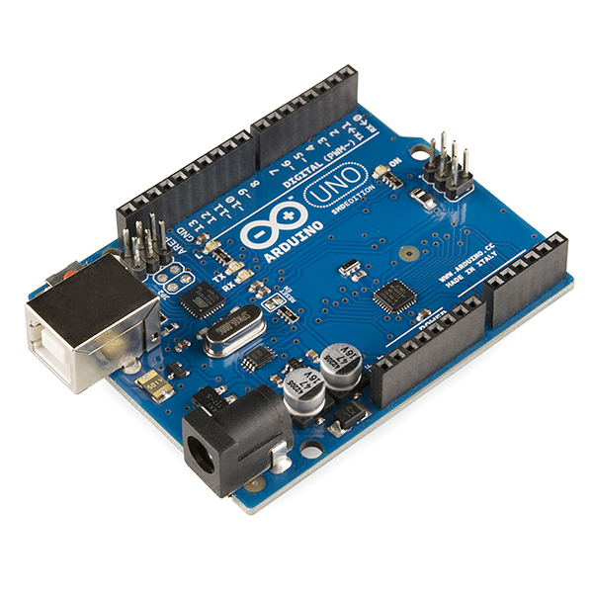
Arduino Uno
The Uno with Cable is a micro-controller board base on the ATmega328. It has 14 digital input/output pins (of which 6 can be used as PWM outputs); 6 analog inputs, a 16 MHz ceramic resonator, a USB connection, a power jack, an ICSP header, and a reset button.
It contains everything need to support the microcontroller; simply connect it to a computer with a USB cable or power it with an AC-to-DC adapter or battery to get started.

Slide 12
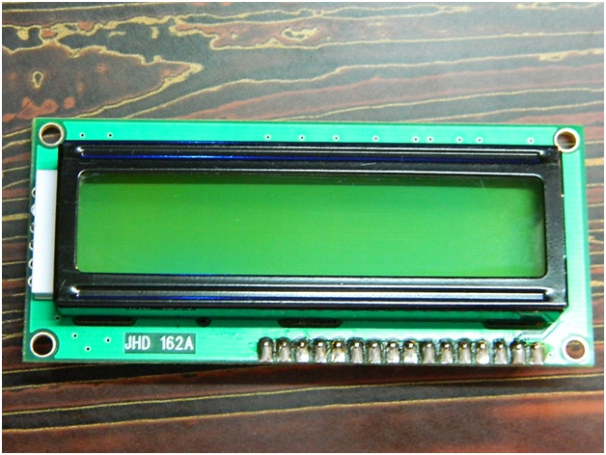
LCD
LCD (Liquid Crystal Display) is the innovation utilized in scratch pad shows and other littler PCs. Like innovation for light-producing diode (LED) and gas-plasma, LCDs permit presentations to be a lot more slender than innovation for cathode beam tube (CRT). LCDs expend considerably less power than LED shows and gas shows since they work as opposed to emanating it on the guideline of blocking light.

Slide 13
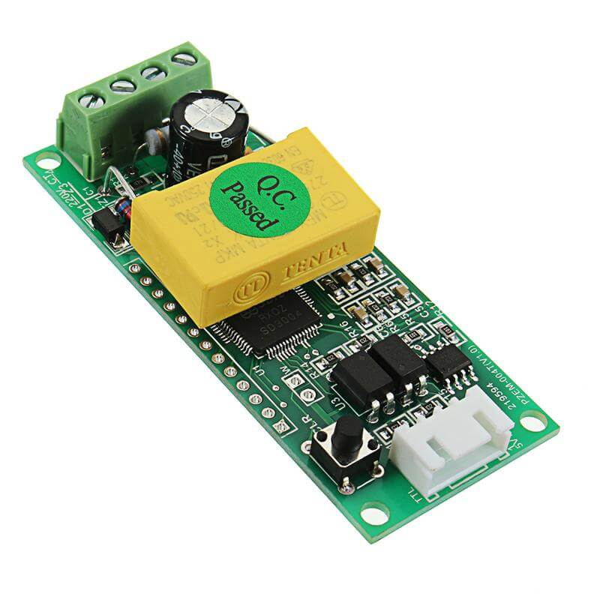
PZEM Module
This Peacefair PZEM-004T Multi-function AC Power Monitor is very popular in electrical consumption measurement projects. It is capable of measuring four interrelated electrical variables as voltage, current, power, and energy.
This tiny PZEM-004T circuit is great for measuring AC (RMS) voltage, current, and power (single-phase).
Simply power the board with a power supply (or you can use the AC source you are measuring) and connect the circular sensor to the board. Run the wire through the circular sensor and you`re ready to start measuring the voltage, current, and power. The circuit also comes with a TTL to USB adapter wire for easy connection to a computer or microcontroller.

Slide 14
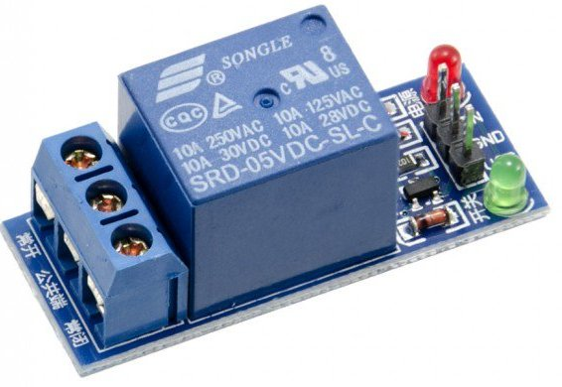
Relay
A relay is an electromagnetic switch that is used to turn on and turn off a circuit by a low power signal, or where several circuits must be controlled by one signal.
Most of the high end industrial application devices have relays for their effective working. Relays are simple switches which are operated both electrically and mechanically. Relays consist of an electromagnet and also a set of contacts

Slide 15
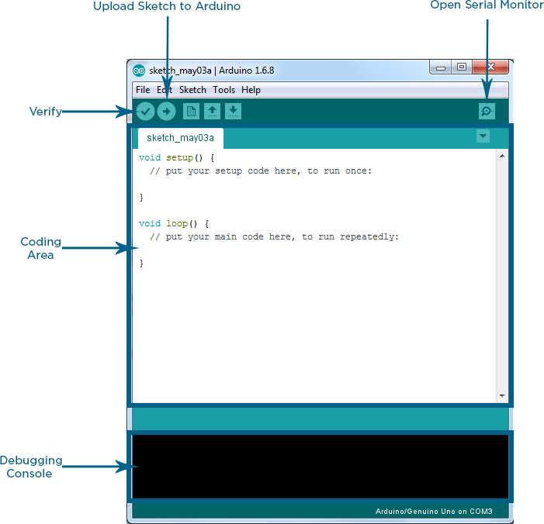
Arduino IDE
Arduino IDE where IDE stands for Integrated Development Environment – An official software introduced by Arduino.cc, that is mainly used for writing, compiling and uploading the code in the Arduino Device. Almost all Arduino modules are compatible with this software that is an open source and is readily available to install and start compiling the code on the go.

Slide 16
Advantages &Applications
ADVANTAGES
• Helpful for Fault Management
• Reduced hazards
• Real time monitoring
• Remote Access
• Periodical collection of data
APPLICATIONS
• Energy production
• Substations

Slide 17
Conclusion
In conclusion, both the Phase Angle Measurement Circuit and the Power Factor Measurement Circuit play crucial roles in assessing and optimizing the performance of electrical systems. The Phase Angle Measurement Circuit offers precise determination of the phase relationship between voltage and current waveforms, aiding in the analysis of system stability and efficiency. On the other hand, the Power Factor Measurement Circuit provides valuable insights into the utilization of electrical power, helping to identify opportunities for improving energy efficiency and reducing wastage. By integrating these circuits into power monitoring and control systems, engineers can enhance the reliability, efficiency, and sustainability of electrical networks across various industries. Together, these circuits contribute to the advancement of electrical engineering practices, enabling the development of more efficient and environmentally friendly power systems for the future.

Slide 18
References
• Li, C., Zhao, Y., & Li, Q. (2017). Phase Angle Measurement of Voltage and Current Signals in Power System Based on Arduino. 2017 IEEE International Conference on Smart Grid and Clean Energy Technologies (ICSGCE). doi: 10.1109/icsgce.2017.241
• Hu, L., Liu, W., Liu, Y., & Chen, W. (2018). Design of a Portable Phase Angle Measurement System Based on Arduino. 2018 IEEE 3rd Advanced Information Technology, Electronic and Automation Control Conference (IAEAC). doi: 10.1109/iaeac.2018.8546823
• Hong, W., & Zhang, J. (2020). Research on Power Factor Measurement Circuit of Smart Meter Based on Improved Design. 2020 International Conference on Electronics Technology (ICET). doi: 10.1109/icet48669.2020.9182821
• Rovira, S., Ordonez, R., & Rodriguez, P. (2015). A Novel Power Factor Measurement Circuit Using Low-Cost Microcontrollers. IEEE Transactions on Instrumentation and Measurement, 64(12), 3441-3450. doi: 10.1109/tim.2015.2418604

